Slide 1


StatsWrap
Make your workout work for you
Alex Laughlin & Tino Pimentel

Slide 2
Our Vision
For a fitness enthusiast that likes to know every intimate detail of their workout, StatsWrap is an activity tracker that records and graphs all of one’s fitness data in real time. This allows athletes to customize their workouts with incredible accuracy. Unlike competitors, StatsWrap focuses on keeping your data secure and presenting high fidelity information in a concise live graph.

Slide 3
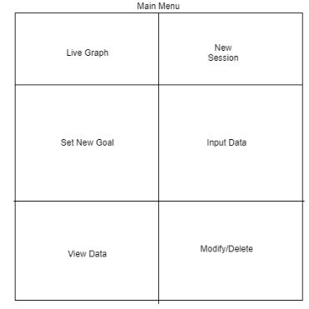
UI Prototype

Slide 4
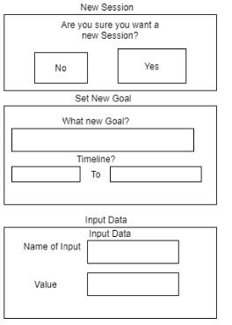
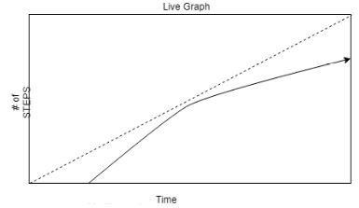
UI Prototype

Slide 5
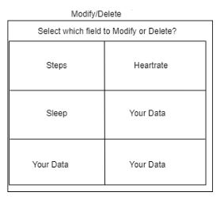
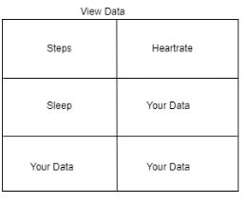
UI Prototype

Slide 6

StatsWrap Security
Popular activity trackers on the market have experienced significant data leaks
StatsWrap focuses on keeping YOUR data in YOUR hands
Limited channels of communication allows for a much more secure system
Data can only leave the device via a physical connection to your PC

Slide 7
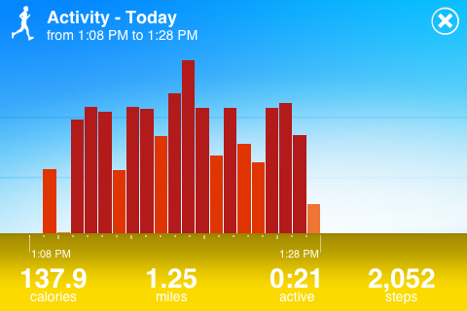
View Live Graphs with StatsWrap!
Select View Live Graphs to see your progress update as you exercise
Select View Historical data to see how far you have come
Data displayed in a meaningful way
Check your progress at a glance

Slide 8
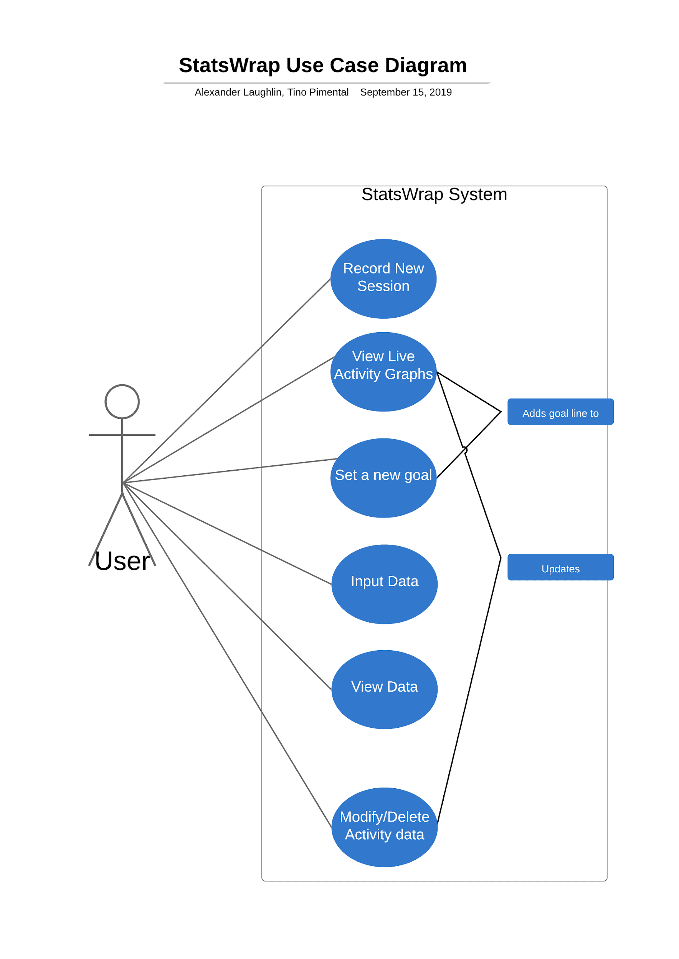
Use Case Diagram
View live activity graphs shows daily progress
Set a new goal allows a user to customize their goals
Input data allows a user to manually insert data to track
User can record a new workout session
View data allows the user to see their statistics
Modify/delete allows the user to change or delete data

Slide 9

Cool Features of StatsWrap
Add a new goal and view graph to see your updated goal line
View your progress with a quick glance using our concise graphs
Manually track other data such as weight, split times, or workout satisfaction
View Historical data to know what workouts work for you

Slide 10
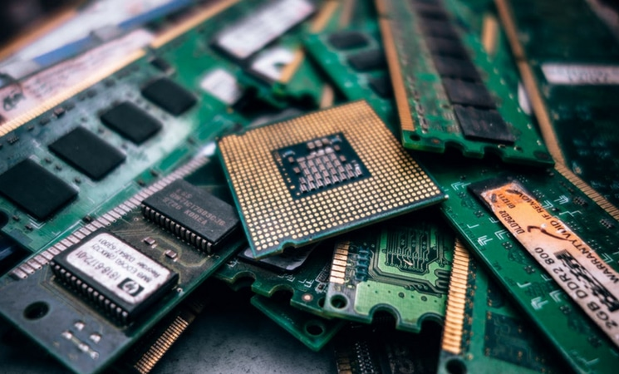
StatsWrap Hardware Requirements
Light sensor using LED technology
126 MB of Disk Space for JRE (Java Runtime Engine)
128MB of RAM
Intel Pentium 2 266 MHz processor
Micro-USB cable

Slide 11
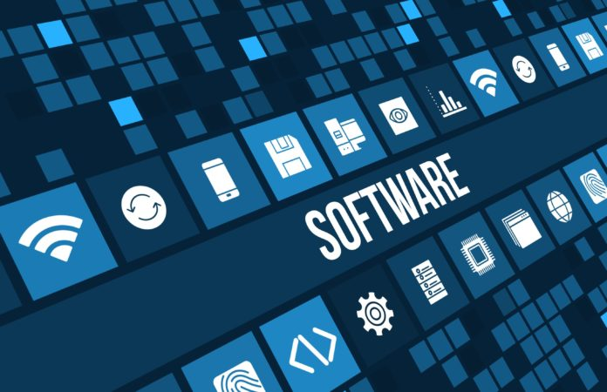
StatsWrap Software Requirements
Installation of Java 8
OS compatible with Java
Scenebuilder
JavaFX

Slide 12

StatsWrap Legal Issues
Activity Tracker Inaccuracies:
An error of the data being read improperly from the light emitting diodes (LEDs). The results presented on the activity tracker software is incorrect and may serve to be unreliable without the customer knowing.
Dangers of Usage:
Users performing dangerous activities such as driving while using the activity tracker is highly not recommended. However, users may be receiving notifications during participation of dangerous activates and could hurt themselves or others. Software should be display information comprehensively and attempt to not be very invasive too frequently.

Slide 13

StatsWrap Glossary
Account Information - The information stored within the activity tracker software which may include activity logs, alarms, and heartrate.
Activity Log(s) - The logged data of all sensors within the Activity tracker
Alarm(s) – time based notifications
Application – a piece of software designed and written to fulfill a specific task
Calorie – the amount of energy required to raise 1 gram of water 1 degree Celsius

Slide 14
More Glossary Terms...
Display - the area of the watch capable of displaying data
Device API - a set of functions and procedures allowing the creation of applications that access the features or data of an operating system, application, or other service.
Component – an aspect of a larger entity
Database – a structured set of data held in a computer, especially one that is accessible in various ways
Settings – options to change how the system looks, works, etc.

Slide 15
Last Set of Glossary Terms I Promise!
Heartrate – number of heart beats per minute (bpm)
LED – abbreviation for Light emitting diode.
Gait – an individual’s manner of walking
Plateau – a period of stagnation in a workout regimen, diminished returns on workouts

